Slide 1
Reinforcement Learning for Generative AI Large Language Models
Yanni Chen, Junyuan Huang, Yi Lu, Xiaolin Sima, Michelle Sun
Satish Banka, Subha Seshagiri

Slide 2
Business Problem and Solution
Business Problem
Proposed Solution
Company documentation such as annual reports and sustainability reports can range from 50 to 500 pages and contain large amounts of both numeric and textual information.
Manually reading through the whole report in this case can be time-consuming.
With the help of LLMs, the process of understanding how the company performs can be efficient.
Develop a system that contains two primary models with the use of LLMs:
a prompt optimizer that will help the user enhance the quality of their instructions to the report analyzer
a report analyzer that will read the documentation, and perform tasks such as generating a summary of the report, or answering specific questions that the user cares about, such as KPIs of the company.

Slide 3



Data Preparation
Source
We gathered our raw pdf data by collecting recent 5-year annual reports, most recent sustainability reports, and 2-3 years quarterly reports directly from the official websites of ten select companies
Load and Split
Company reports are rich in text, images, tables, and graphs.
Parsing PDFs extracts insights from various formats.
Data splitting breaks down large documents into manageable chunks.
Chunks serve as a knowledge base for LLM.
Chunk configurations influence the PDF's representation.
Effective segmentation improves information retrieval and system speed.
Similarity Search
（Report Analyzing Model）
Used Facebook AI Similarity Search (FAISS) for text analysis in oil company reports.
FAISS retrieves relevant text for specific queries.
Process involves creating and organizing text embeddings.
Improves precision in text retrieval for Language Model.
Leads to more accurate analysis.

Slide 4


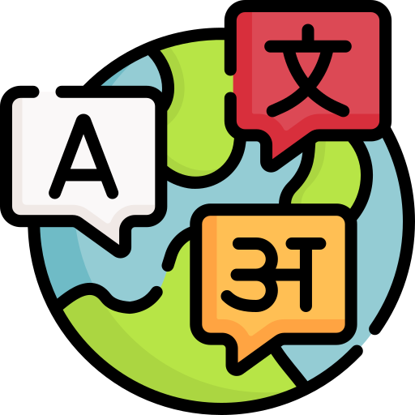




Modeling and Tuning
User Prompt
Prompt Optimizing Model
Report Analyzing Model
Output for Users
Prompt Optimization:
Uses Black-Box Method for LLM training
Objective:
Enhance prompt quality for report analysis
Report Analysis: Processes reports using optimized prompts
Objective:
Summarize reports, extract key performance indicators

Slide 5

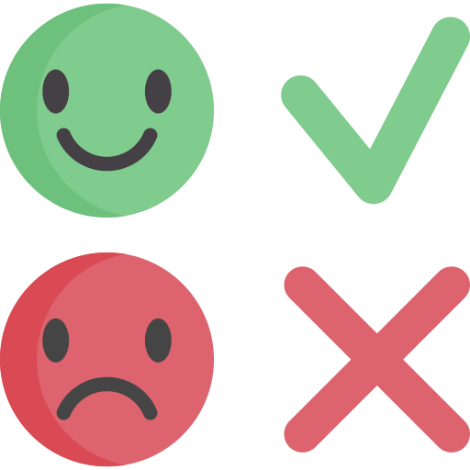


Prompt Optimizing Model (BPO Algorithm)
Step1 Feedback Data Collection
Step 2 Optimized Prompt Construction
Step 3 Prompt Optimizer Training
Write a prompt to do summarization
Instruction: Summarize the company's performance and future plans according to the CEO's letter
This is a good response: …
This is a bad response : ...
Original Prompt: Summarize the company's performances and future plans according to the CEO's letter
Optimized Prompt: Summarize CEO letter to shareholders, covering the company's performance, values, initiatives, market resilience, safety focus, environmental efforts, social contributions, and commitment to meeting global energy needs and addressing climate change
Response 1
Chevron emphasizes the importance of its people and culture in its performance, with a focus on values such as diversity and inclusion, high performance, innovation, integrity, and trust....
Response 2
2018 is a good year for Chevron
Paired Optimized Prompt
Criticize
Compare the good and bad response from the following aspects: ......
The bad response does not capture the key information of the companies overview of the year...
Optimize
Be an expert prompt engineer. Improve my instruction upon above aspects ......
Summarize CEO letter to shareholders, covering the company's performance, values, initiatives, market resilience, safety focus, environmental efforts, social contributions, and commitment to meeting global energy needs and addressing climate change
Training a seq2seq model as the prompt preference optimizer
Paired Preference
Feedback Dataset
{Instruction}
{Good Response}
{Bad Response}
The BPO algorithm operates by enabling the model to optimize the prompt itself by learning what is a good prompt that can produce ideal result. In our approach, we utilized our dataset to fine-tune the THUDM/BPO model, which is based on Llama 2.

Slide 6


Report Analyzing Model
Summarization for Annual Highlights
User Prompt
Report Analyzer (Tuned Llama2 Model)
Output for Users
Q&A for Major KPIs
We aim to comprehensively analyze a targeted company's report, focusing on two key aspects:
summarizing annual highlights
extracting major KPIs.
To accomplish this, we fine-tuned the Llama2 model using a custom dataset that includes informative summarizations and accurate KPI extractions. Specifically, the model adeptly identifies the CEO report—a key source of annual highlights—and produces concise and insightful summarizations. In terms of Q&A, the model can answer the questions provided by users, focusing on KPI.

Slide 7
Result of the models after fine-tuning
Prompt Optimization Model
 | Rouge Score | Bleu Score
Before Fine-Tuning | 0.25 | 0.03
After Fine-Tuning | 0.32 | 0.05
Report Analyzation Model
 | Rouge Score | Bleu Score
Before Fine-Tuning | 0.21 | 0.45
After Fine-Tuning | 0.26 | 0.46

Slide 8
Reinforcement Learning Initial Approach
Manual Labeling Process:
Ranking LLM-produced answers based on accuracy, readability, etc.
Training Reward Model:
Using labeled data to train GPT2-based reward model via supervised learning.
Proximal Policy Optimization (PPO):
Employing PPO for prompt completion experiments and response ranking.
Model Benchmarking:
Fine-tuned LLama as reference, using frozen weights.
KL Divergence Penalty:
Ensures model alignment with reference during hallucinations.
Parameter-Efficient Fine-Tuning (PEFT) Adapter:
Enhances PPO model responsiveness and alignment.

Slide 9
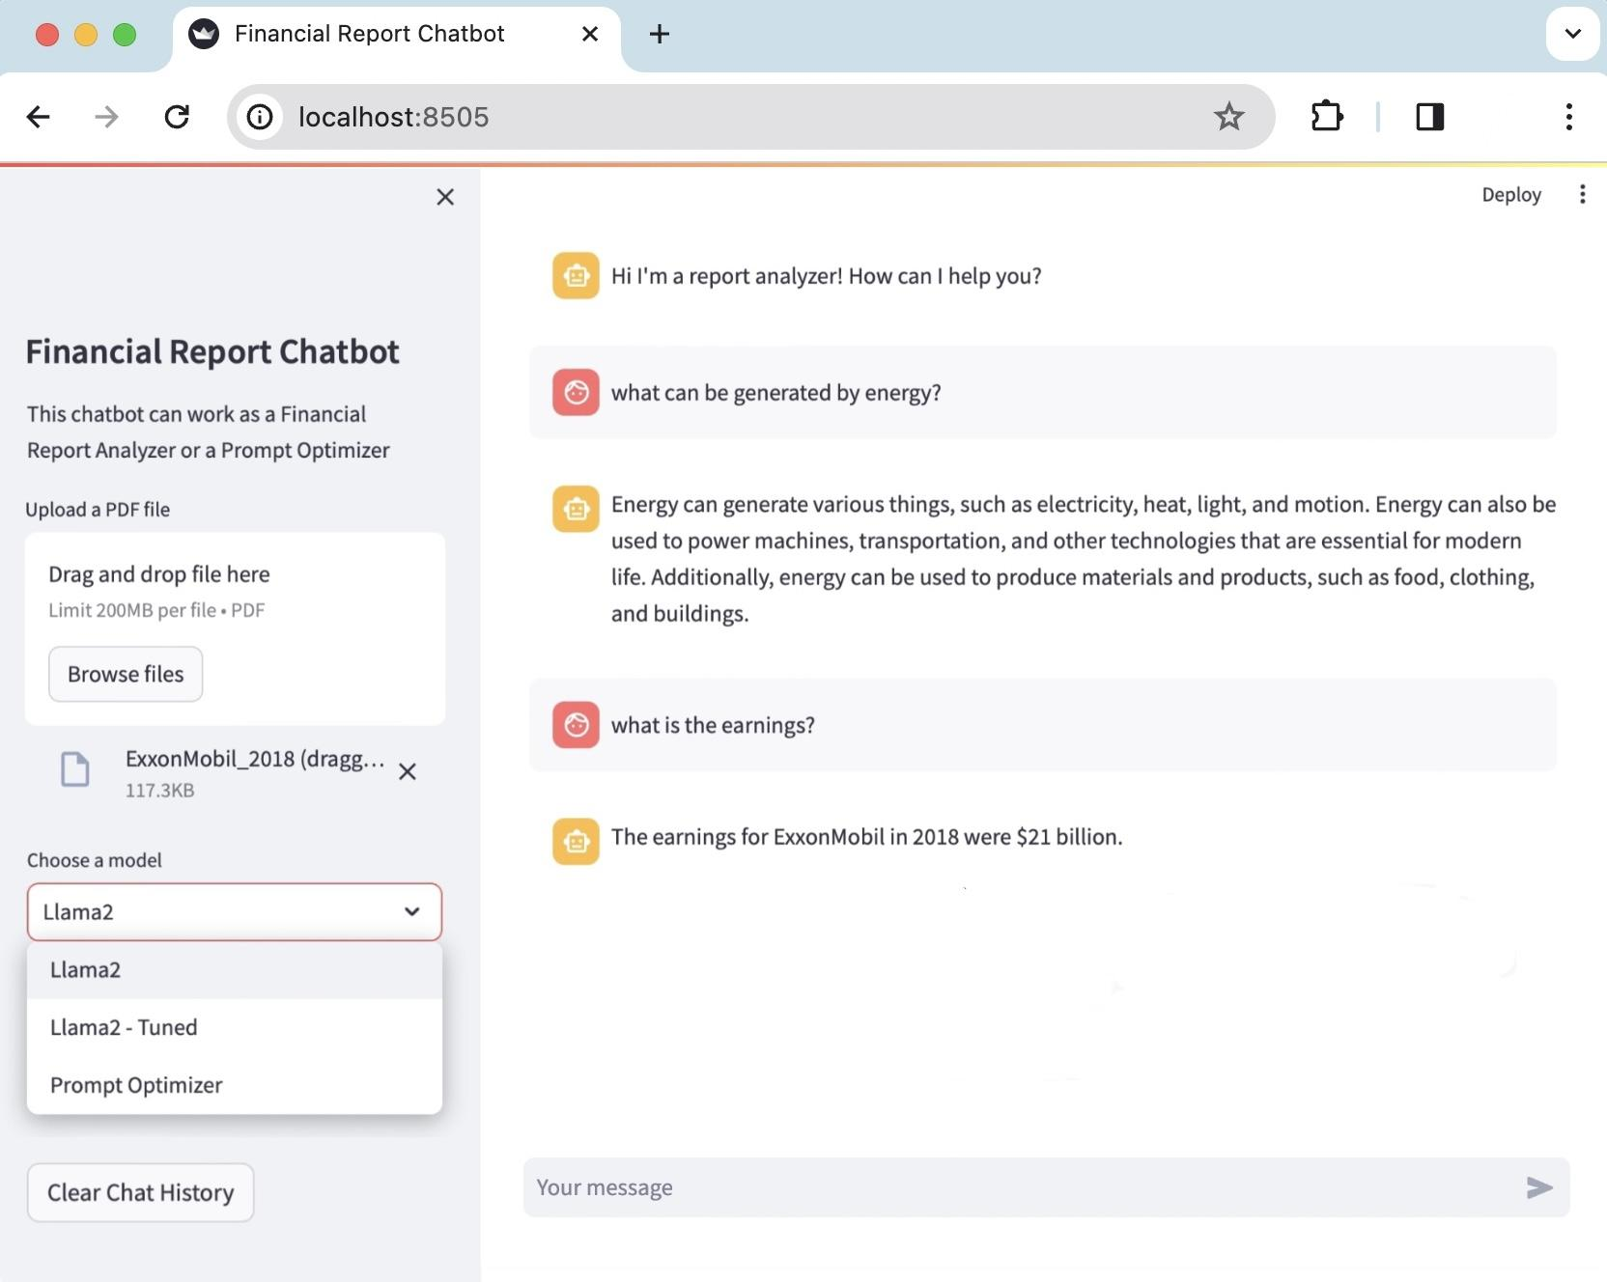
UI Interface Design
As a final deliverable, we deploy our Prompt Optimizer and Report Analyzer into a web app through Streamlit. On the left-hand side bar, users are able to drop their files and specify which model they would like to use. On the right-hand side, users can enter their message and start a conversation with the chatbot.

Slide 10
Next Steps
MOVE TO PRODUCTION
More intricate UI interface deployed on company’s server
DATA IMPROVEMENT
A larger dataset for fine-tuning the model
MODEL IMPROVEMENT
Designing a more comprehensive rewarding system for reinforcement learning

